Slide 1
The Software Development Process
Leaving Cert Computer Science

Slide 2
Introduction
The terms software engineering and software development are used interchangeably.
The term software engineering was coined by Margaret Hamilton who led a team that developed the flight software for the NASA Apollo program in 1960’s.
Most software development projects follow an organised, structured process because this results in a greater chance of:
  Meeting the needs of the user
  Keeping the cost of development within budget
  Delivering the software on time
  Minimising the cost of maintenance

Slide 3
Introduction
When developing a solution to a problem for a computer system, programmers work through a number of distinct stages.
Collectively, these stages are known as the Software Development Lifecycle (SDLC).
The arrangement of these stages and how programmers move from one stage to another, is known as the Software Development Methodology
The 2 main methodologies you need to be aware of are:
  Waterfall
  Agile

Slide 4
The Client and the user
The client is the person in an organisation who has commissioned the software project
The User, the individual(s) who will actually be using the software

Slide 5
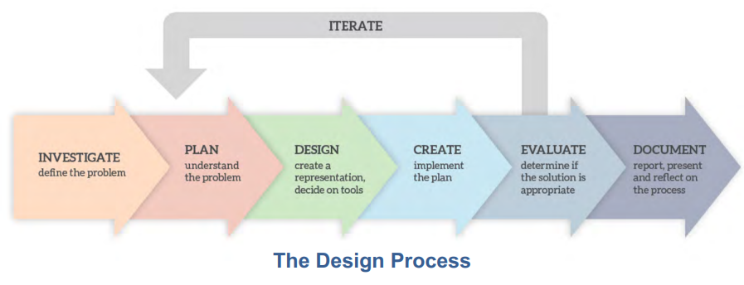
Stages of Software Development Life Cycle

Slide 6
Stage 1 -> Investigate (Analyse)
Understand the problem: the developers need to know what they're trying to solve. They figure out what the software needs to do, who will use it, and what problems it should solve.
Research: Next, they look at similar projects or existing solutions to gather ideas and learn from them. This helps them avoid repeating mistakes and find better ways to approach the problem.
Gather Requirements: This step involves talking to the people who will use the software (BOTH clients and end-users) to understand their needs and preferences. They ask questions to clarify what features the software should have and how it should work.

Slide 7
Stage 1 -> Investigate (Analyse)
Hardware and Software Requirements: An initial assessment of the most suitable hardware and software to be used is made
Carry out a feasibility study: The developers check if what the client wants is possible within the available resources like time, budget, and technology. A report is written for the client giving an opinion as to whether a feasible solution to the problem is possible.

Slide 8
Stage 2 -> Plan
A software development plan is necessary to ensure that everyone concerned understands clearly what must happen, when and by whom, in order to complete the new software system.
Timescales: A timeline or schedule is made to outline when each part of the project should be completed. This helps keep everyone on track and ensures the project stays on schedule.
Assign Tasks: Roles and responsibilities are defined, and tasks are assigned to different team members based on their skills and expertise.
Budgeting: The budget for the project is planned out, including costs for resources, tools, and personnel.

Slide 9
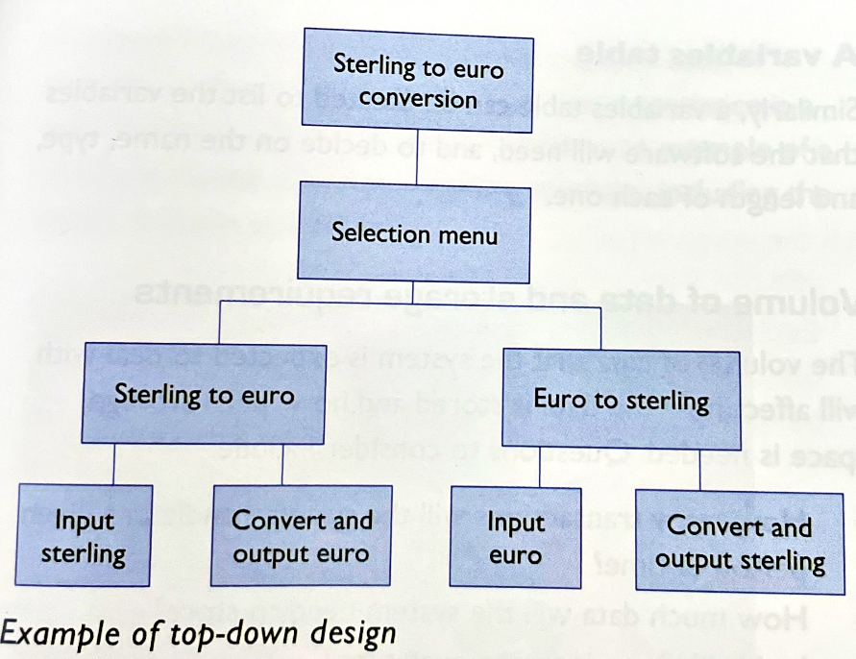
Stage 3 -> Design
There are many different approaches to software design, each with their own advantages and disadvantages. Not all of these approaches are used on any given project.
Top Down Design -> A top-down design approach starts with the main system at the top and breaks it down into smaller units, in a hierarchical fashion. Each unit is broken down until each aspect is manageable. This is an example of DECOMPOSITION

Slide 10
Stage 3 -> Design
Modular Design -> This a software design approach where a system is divided into a set of smaller, independent software modules. Each module is responsible for a distinct aspect of the system’s functionality and can be developed, tested, and maintained separately.
The benefits of Modular Design are:
The modules of code can be re-used, even on other projects.
Each module is relatively small so problems and bugs are easier to find and fix.
The design of the system as a whole is easier to understand, and manage.

Slide 11
Stage 3 -> Design
User Interface Design: This is like designing the layout and appearance of rooms in a house. Designers figure out how users will interact with the software, like where buttons will be placed and how screens will look.
Flowcharting : This can be used at the design stage to represent the flow of operation of the system. Flowcharts provide a clear way of communicating the software solution visually. This results in:
  A shared understanding on the part of the team and users
  A means of checking that the development process is correct
  A way of identifying and getting rid of unnecessary steps.

Slide 12
Stage 3 -> Design
Prototyping : Sometimes, designers create prototypes, which are like rough drafts or models of the software. This helps them see how things will work and get feedback from users and clients before building the final product.
Description of Algorithms -> All the main functionalities that the software will require should be listed and their algorithms described. The descriptions can be written in pseudocode, normal language or flowcharts
Data Tables -> A data table lists all the data to be used, its type and how it will be stored.
Variables Tables -> A variable table can be created to list all the variables that the software will need, and to decide on the name, type, and length of each one.

Slide 13
Stage 3 -> Design -> USER CENTRED DESIGN
User centered design gives top priority to the needs of the user. It is important the user can use the software as effectively as possible. The users themselves should be involved to make sure the software is useable by ALL users.
Two important considerations for user-centered design are:
USER EXPERIENCE (UX)
UNIVERSAL DESIGN
Video on User Centred Design

Slide 14
Stage 3 -> Design -> USER CENTRED DESIGN
USER EXPERIENCE
  This is the experience of the user when interacting with the product or software. This includes perception, preferences, emotions and other factors before, during and after use. A key part of user experience is the USER INTERFACE (UI). This could be the physical buttons and dials on a washing machine or the graphical interface of an operating system or website.
UNIVERSAL DESIGN (UD)
  This can be applied when designing anything from a car, to furniture to software. Universal design is the process of designing a product so that everyone can understand, access and use it, regardless of their age, size or ability.

Slide 15
Stage 3 -> Design -> Universal Design
Video on universal design

Slide 16
Stage 3 -> Design -> Adaptive and Assistive Technology
Adaptive Technologies -> provide features to existing technologies to aid their use specifically for people with impairments and disabilities, and older people. Adaptive technologies would RARELY be used by non-disabled people. Examples are screen-readers, alternative keyboards and text-to-speech synthesizers.
Assistive Technology - > this refers to something that can help people with disabilities, but also may be used by the non-disabled. An example is the Microsoft Windows Magnifier app which allows users to magnify anything on-screen

Slide 17
Stage 4 -> Create
This is the stage the software is actually written AND tested. The programmers create the system based on all the work that has been carried out during the previous stages.
The design of the system may be changed as a result of an issue that happens during its coding. This is another example of iteration, where you loop back to an earlier stage.
Such iteration can cause delays to the programming schedule.
Testing will be carried out during the Create Stage

Slide 18
Stage 4 -> Create (The General Steps in Testing)
Requirement Understanding: Testers need to understand what the software is supposed to do. This involves reading the requirements documents or discussing with stakeholders to know the expected behavior of the software.
Test Planning: Testers plan how they're going to test the software. They decide what to test, how to test it, and what resources they'll need.
Test Case Design: Testers create specific scenarios, called test cases, that they'll use to check if the software behaves as expected. These test cases include steps to follow and expected results.
Test Execution: Testers actually run the test cases. They interact with the software, input data, and observe the output to see if it matches what's expected.

Slide 19
Stage 4 -> Create (The General Steps in Testing)
5. Defect Reporting: If testers find any issues during testing, they report them. They provide details like what they did, what went wrong, and how severe the issue is.
6. Defect Resolution: Developers fix the reported issues. Testers verify these fixes to make sure they work correctly and don't cause new problems.
7. Regression Testing: Testers re-run previous tests to ensure that the fixes and changes haven't broken anything else in the software. This helps maintain overall quality.
8. Test Closure: Once testing is complete and the software meets the desired quality standards, testers document the results and close out the testing process.
These steps form a cycle, and they may be repeated multiple times during the software development lifecycle to ensure the software meets user expectations and quality standards.

Slide 20
Stage 4 -> Create (Unit Testing & Integration Testing)
Unit Testing
Individual components or units of code are tested in isolation to ensure they work correctly. Each unit, like a function or method, is tested independently to verify that it produces the expected output for a given input. Unit tests help developers catch bugs early, maintain code quality, and ensure that each piece of code functions as intended before integrating it into the larger software system.
Integration Testing
Integration testing is like assembling a puzzle to see if all the pieces fit together. It's a testing technique in software development where individual units or components of a system are combined and tested as a group to ensure they interact correctly. The focus is on verifying that the interfaces between these components work as expected and that they communicate and exchange data properly.

Slide 21
Stage 4 -> Create (White Box Testing)
White Box Testing or Structural Testing
Imagine you’re an electrician tasked with checking the wiring in a house. White Box Testing is like having the complete blueprint of the house, including all the hidden electrical circuits, outlets, switches, and even the color coding of the wires. You’re not just checking if the lights turn on when you flip the switch (that would be more like Black Box Testing), but you’re examining the actual wiring behind the walls.
White Box Testing, or structural, code-based, or glass box testing, is a software testing technique that focuses on the software’s internal logic, structure, and coding. It provides testers with complete application knowledge, including access to source code and design documents, enabling them to inspect and verify the software’s inner workings, infrastructure, and integrations.

Slide 22
Stage 4 -> Create (Functional Testing)
Functional Testing also known as Black Box Testing
Software functional testing involves verifying that a piece of software or an application meets its functional requirements. In other words, it ensures that the software performs the specific functions it's designed to do accurately and reliably.
During functional testing, testers typically focus on testing individual features or functionalities of the software to confirm that they behave as expected. This can involve testing various inputs and scenarios to ensure that the software responds correctly and produces the expected outputs.
Functional testing is often carried out through a combination of manual testing, where testers interact with the software directly to validate its behavior, and automated testing, where scripts are created to simulate user interactions and verify expected outcomes automatically.

Slide 23
Stage 4 -> Create (System Testing)
System Testing
System testing differs from functional testing in that it tests the entire system while functional testing only tests a single function or feature at a time.
The aim of system testing is to ensure the software meets the client and users requirements.
System testing can be broken down into ALPHA and BETA testing
  Alpha testing refers to testing the software in-house. It aims to test as many paths through the system as possible in order to discover problems and fix them before the system is tested by users.
  Beta testing occurs when an early version of the software is sent to potential users for testing. Users perform tests that are typical of what would take place in real life conditions. They record any problems that they find and notify the developers who must then rectify the problem

Slide 24
Stage 4 -> Create (Non-functional Testing)
Non-functional Testing
Purpose: Non-functional testing evaluates the performance, reliability, usability, and other non-functional aspects of the software system. It ensures that the software meets quality attributes beyond just its functional requirements.
Focus: It focuses on characteristics like performance, reliability, security, usability, scalability, and maintainability.
Examples: Load testing, stress testing, security testing, usability testing, reliability testing, and compatibility testing are all examples of non-functional testing. These tests evaluate how the system behaves under various conditions and assess its compliance with non-functional requirements.

Slide 25
Stage 4 -> Create (Acceptance Testing)
Acceptance Testing
Firstly, programs are tested with normal, erroneous and boundary data.
Then, unit testing, module testing, and system testing is carried out.
Then, the system is tested whether it meets the user’s requirements. This is called acceptance testing.
The test data supplied to the acceptance data is supplied by the end-user instead of the data used for testing purposes.
The system is also tested in an environment where a realistic volume of data is supplied. This is a part of the hand-over process and is carried out by the intended user.

Slide 26
Stage 5 -> Evaluate
When the testing is over, a broader evaluation of the system should take place. This evaluation compares the finished system with the specifications of the requirements.
This phase comes to action three to six months after the software has come to use.
This time duration allows the user and organisation to get used to the new software environment.
User may identify a few shortcomings at this stage and their feedback is evaluated.
The software must be effective in solving the problem, easy to use and easy to maintain.

Slide 27
Stage 6 -> Document
Effective communication is key to the success of any software project. This includes meetings and phones calls as well as more formal documentation.
The specific documents produced will vary from project to project.This will include:
  Feasibility Study
  Specifications of Requirements
  Project Plan
  Design Documents
  The code itself with comments andsupporting technical documentation
  Test Plans & Test Data & Test Results
  System Documentation of the final version
  Installation & set-up guide
  Training & End-user documents
  Evaluation Report

Slide 28
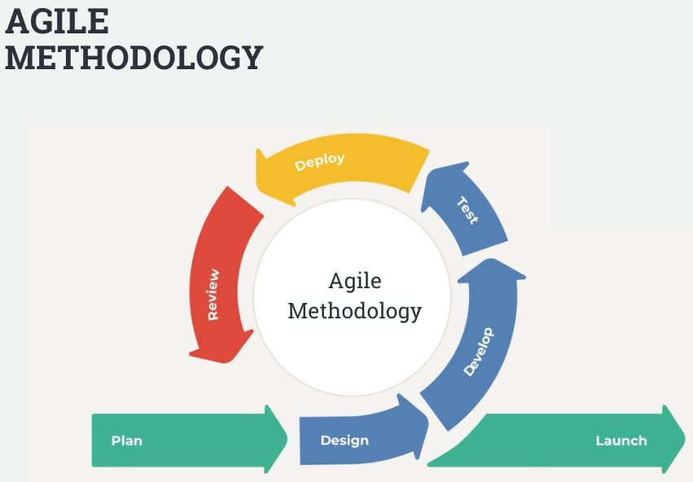
Agile Software Development Methodology
Imagine building a house. Instead of planning every detail upfront and building it all at once, Agile is like building one room at a time, getting feedback from the homeowner as you go.
In software development, Agile means breaking the project into small pieces called "sprints." Each sprint typically lasts a few weeks, and the team works on a specific set of tasks during that time. After each sprint, there's a review where the team and stakeholders give feedback, and adjustments are made for the next sprint. This way, the software evolves gradually, adapting to changing needs and priorities along the way. It's like taking small steps forward, always ready to adjust course based on feedback.

Slide 29
Agile Software Development Methodology
Pros of Agile Methodology:
Flexibility: Easily adapts to changes in requirements and priorities.
Faster Delivery: Incremental development leads to quicker delivery of working software.
Stakeholder Engagement: Regular collaboration ensures alignment with customer needs.
Continuous Improvement: Iterative approach allows for ongoing enhancements and feedback.
Reduced Risks: Early detection and mitigation of issues lead to minimized project risks.

Slide 30
Agile Software Development Methodology
Cons of Agile Methodology:
Lack of Predictability: Difficulty in estimating timelines and project costs accurately.
Resource Intensive: Requires active participation and commitment from all team members.
Dependency on Customer Availability: Relies on consistent feedback and involvement from stakeholders.
Documentation Challenges: Emphasis on working software over comprehensive documentation can lead to insufficient documentation.
Scope Creep: Susceptible to the addition of new features or requirements throughout the development process, potentially impacting project scope and deadlines.

Slide 31
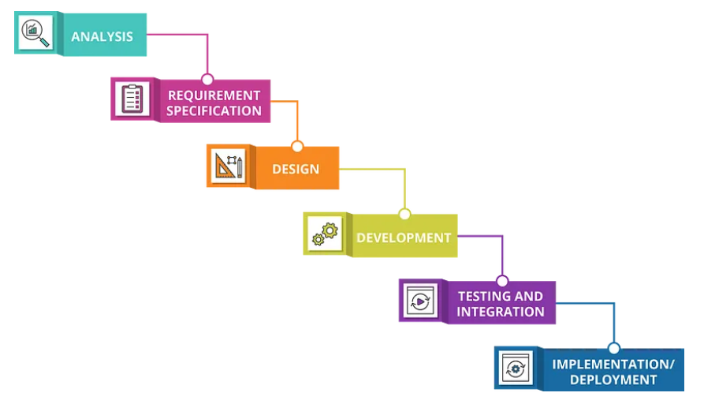
Waterfall Software Development Methodology
Waterfall software development is a traditional approach to creating software that follows a sequential, linear process. In the waterfall model, each phase of development must be completed before moving on to the next phase, similar to water flowing downward in a waterfall.
Waterfall development is characterized by its rigid structure and emphasis on extensive upfront planning and documentation. While this approach can provide clarity and predictability, it can also be less flexible and less responsive to changes compared to Agile methodologies. Issues or changes discovered late in the process can be more difficult and costly to address in a waterfall model.

Slide 32
Waterfall Software Development Methodology
Pros of Waterfall Software Development:
Clear Structure: The sequential nature of waterfall development provides a clear roadmap for the entire project, making it easier to plan and manage.
Early Documentation: Requirements and design documentation are established upfront, providing a comprehensive understanding of the project scope and objectives.
Predictability: Waterfall development often results in more predictable timelines and budgets, as each phase is completed before moving on to the next.
Stakeholder Involvement: Stakeholders have a clear understanding of the project's progress and can provide input at each stage.

Slide 33
Waterfall Software Development Methodology
Cons of Waterfall Software Development:
Limited Flexibility: Changes in requirements or priorities can be difficult and costly to implement once the project is underway, as each phase must be completed before moving on to the next.
Late Feedback: Stakeholders may not see the software until late in the development process, leading to potential misunderstandings or misalignments with expectations.
Risk of Requirements Errors: Since all requirements are gathered upfront, there's a risk of overlooking or misunderstanding key requirements, which may not be discovered until later stages.
Difficulty Managing Complex Projects: Waterfall is less suited for large, complex projects where requirements may evolve over time or where there's a need for rapid iteration and feedback.

Slide 34
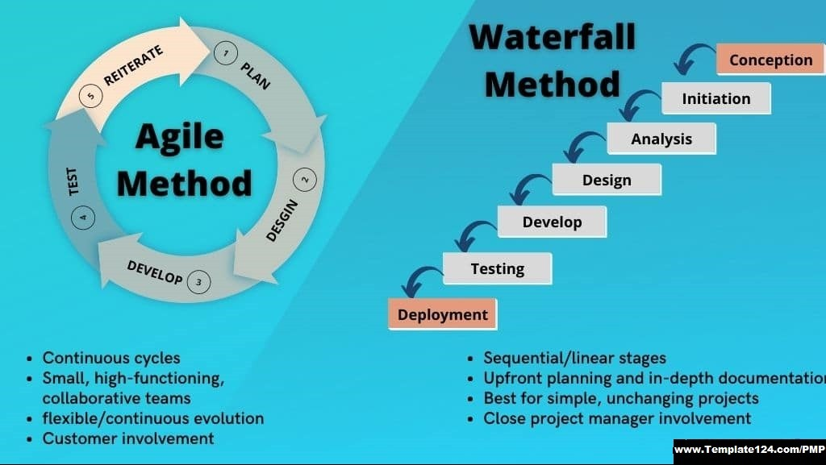

Slide 35
Roles in a Software Development Team
Project Manager
  Involved in producing the feasibility study and the specification of requirements
  Forms the project team and the supervises their work
  Ensures that the workloads are properly allocated
  Monitors everyone’s progress and ensure the project stays on track both timewise and financially
  Main point of communication between the client and the development team and regularly communicates with both parties to ensure any problems are reported and sorted out

Slide 36
Roles in a Software Development Team
Business Analyst
  Involved in the Investigation Stage, before the rest of the team is formed
  A business analyst acts like a bridge between the technical side of things and the business goals. They talk to different people, like clients or end users, to understand what they need from the software. Then, they translate those needs into requirements that the development team can understand and work on. They're kind of like detectives, investigating what the software should do and making sure everyone's on the same page before the development work starts.

Slide 37
Roles in a Software Development Team
Systems Analyst
  Involved in the Investigation Phase, before the rest of the team is formed
  A system analyst is like a detective who investigates how different parts of a software system should work together. They talk to users, study existing systems, and figure out what changes or improvements are needed. Then, they create detailed plans and diagrams to guide the development team in building the right solution. They're like architects, designing the blueprint for the software before it's built.

Slide 38
Roles in a Software Development Team
Designer
  Designs the software to meet the specification
  Produces the design documentation

Slide 39
Roles in a Software Development Team
Developer
  Writes the code
  Maintains backup copies of the programs
  Carries out unit testing
  Produces the software documentation

Slide 40
Roles in a Software Development Team
Tester
  Produce the test plans and the test data
  Carries out all the testing
  Documents all the test results and make sure they are reported to the developers.

